Slide 1



customer behavior analysis

Slide 2

Team Members
Mohamed Mostafa
Khaled Walid
Mayar Elshamy
Ashraket Maher

Slide 3
Agenda Slide
Introduction and Background
Project Aim and Project Objectives
System Architecture and Overall Architecture
Technology Stack and Database Design
Real-Time Data Pipeline
Apache Kafka
Apache Spark Streaming
Customer Behavior Analysis
Website Features
Real-Time Statistics
Results & Benefits

Slide 4

Introduction and Background
The rapid growth of e-commerce platforms has generated massive volumes of customer interaction data every second. These interactions include product searches, product views, shopping cart activities, purchases, ratings, and recommendation clicks.
Traditional analytics systems store this information for later analysis, making it difficult to respond to customer behavior in real time.
Our project introduces a real-time customer behavior analytics platform that continuously captures, processes, and analyzes customer activities using Apache Kafka and Apache Spark Streaming. This enables instant business insights, personalized recommendations, and data-driven decision-making.
Introduction

Slide 5
Introduction and Background
Modern companies such as Amazon and Netflix rely on event-driven architectures that process millions of user interactions every second.
Instead of analyzing historical data only, real-time analytics enables businesses to:
Understand customer interests instantly
Improve recommendation quality
Monitor sales performance
Increase conversion rates
Make data-driven decisions
Background

Slide 6
Project Aim and Project Objectives
Project Aim
To develop a scalable real-time customer behavior analytics platform capable of monitoring customer interactions, generating business intelligence, and providing personalized product recommendations through distributed stream processing.
PROJECT OBJECTIVES
Develop a complete e-commerce platform.
Design a normalized relational database.
Track customer interactions in real time.
Stream events using Apache Kafka.
Process streaming data using Apache Spark Streaming.
Store analytics results in SQL Server.
Build an interactive analytics dashboard.
Improve customer engagement and business decision making.

Slide 7
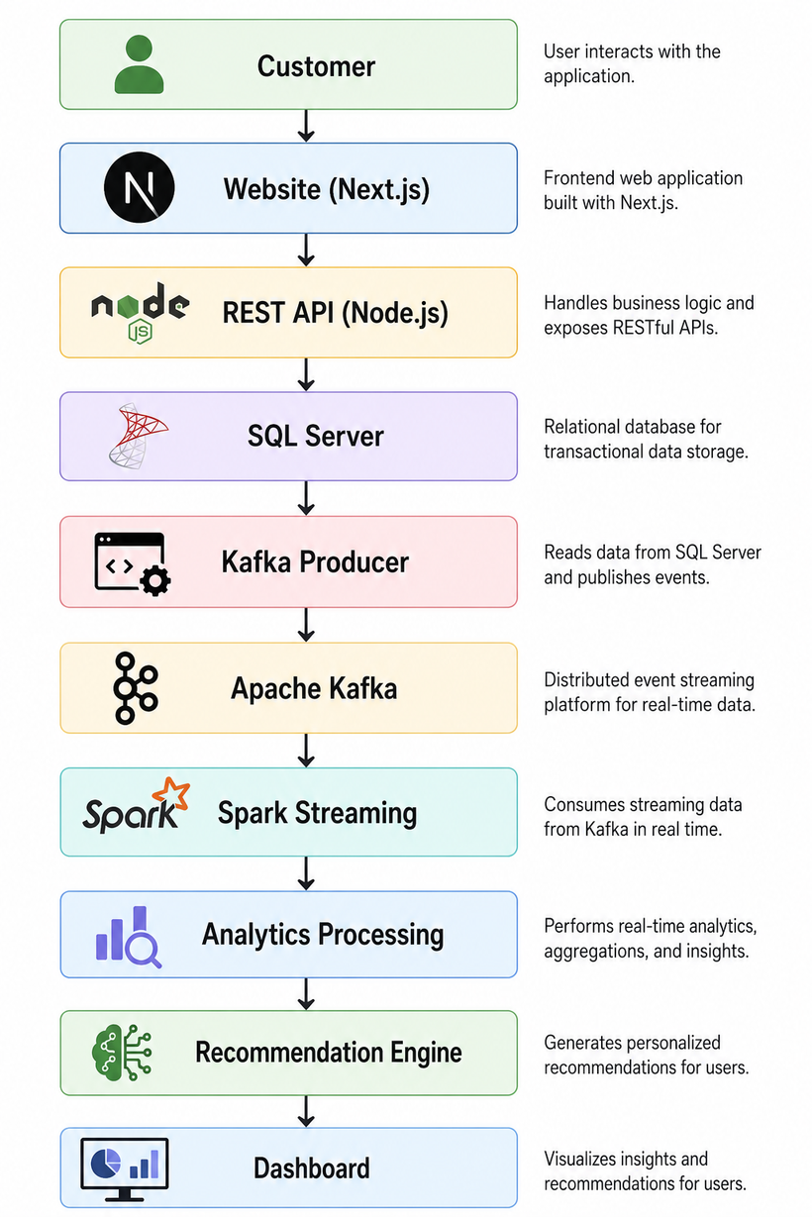
Overall System Architecture
The website captures every customer interaction.
Events are published to Kafka.
Spark Streaming processes these events continuously.
Analytics are stored in SQL Server.
The recommendation engine generates personalized suggestions.
The dashboard visualizes the analytics in real time.

Slide 8
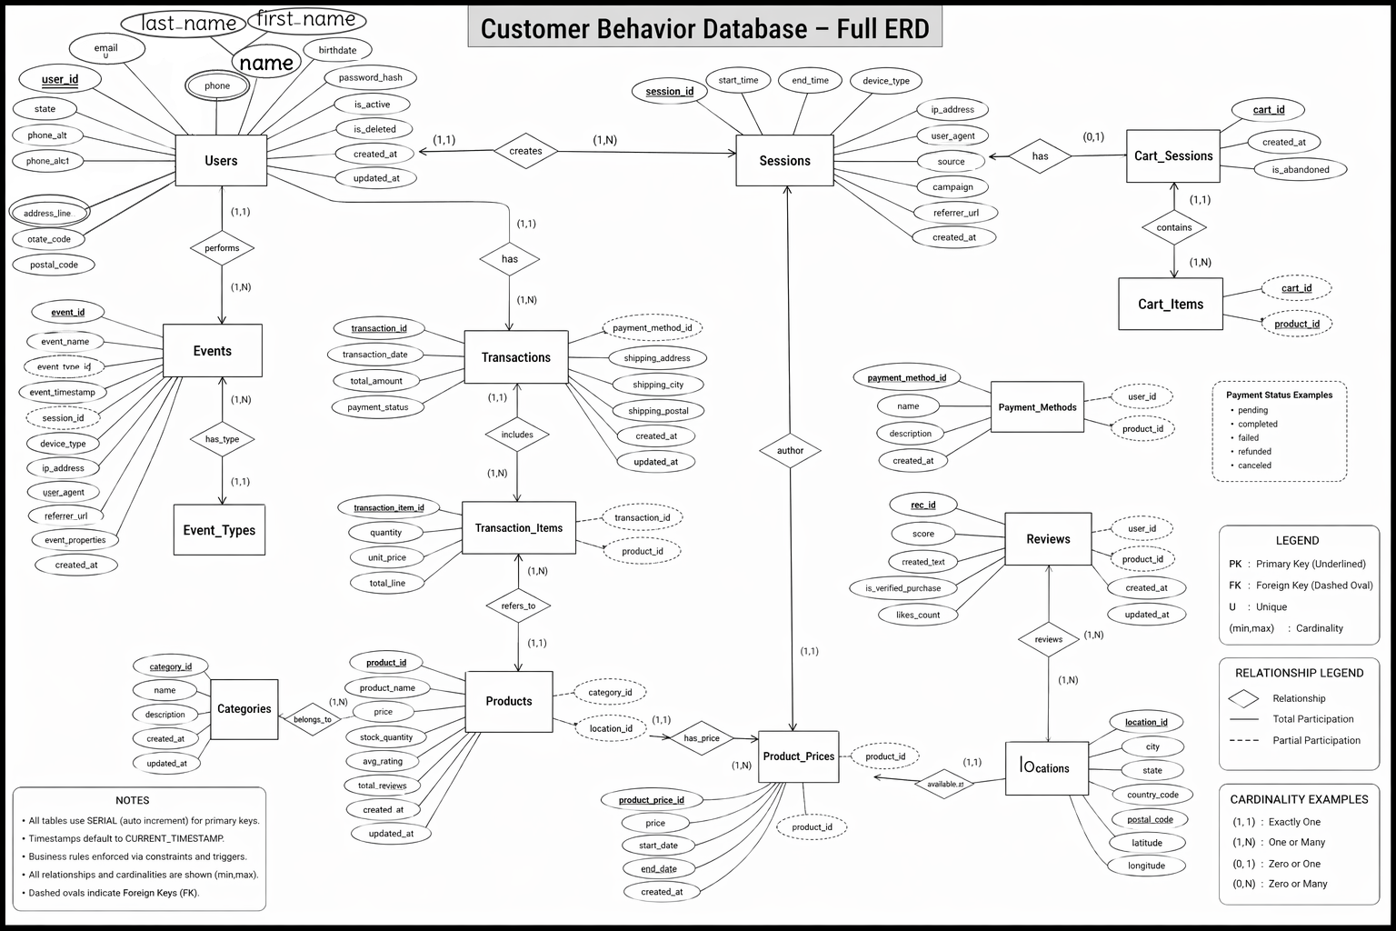

Database Design
Entity-Relationship Diagram (ERD) for a customer behavior tracking system, designed to model user interactions, transactions, products, and shopping sessions in an e-commerce environment.

Slide 9
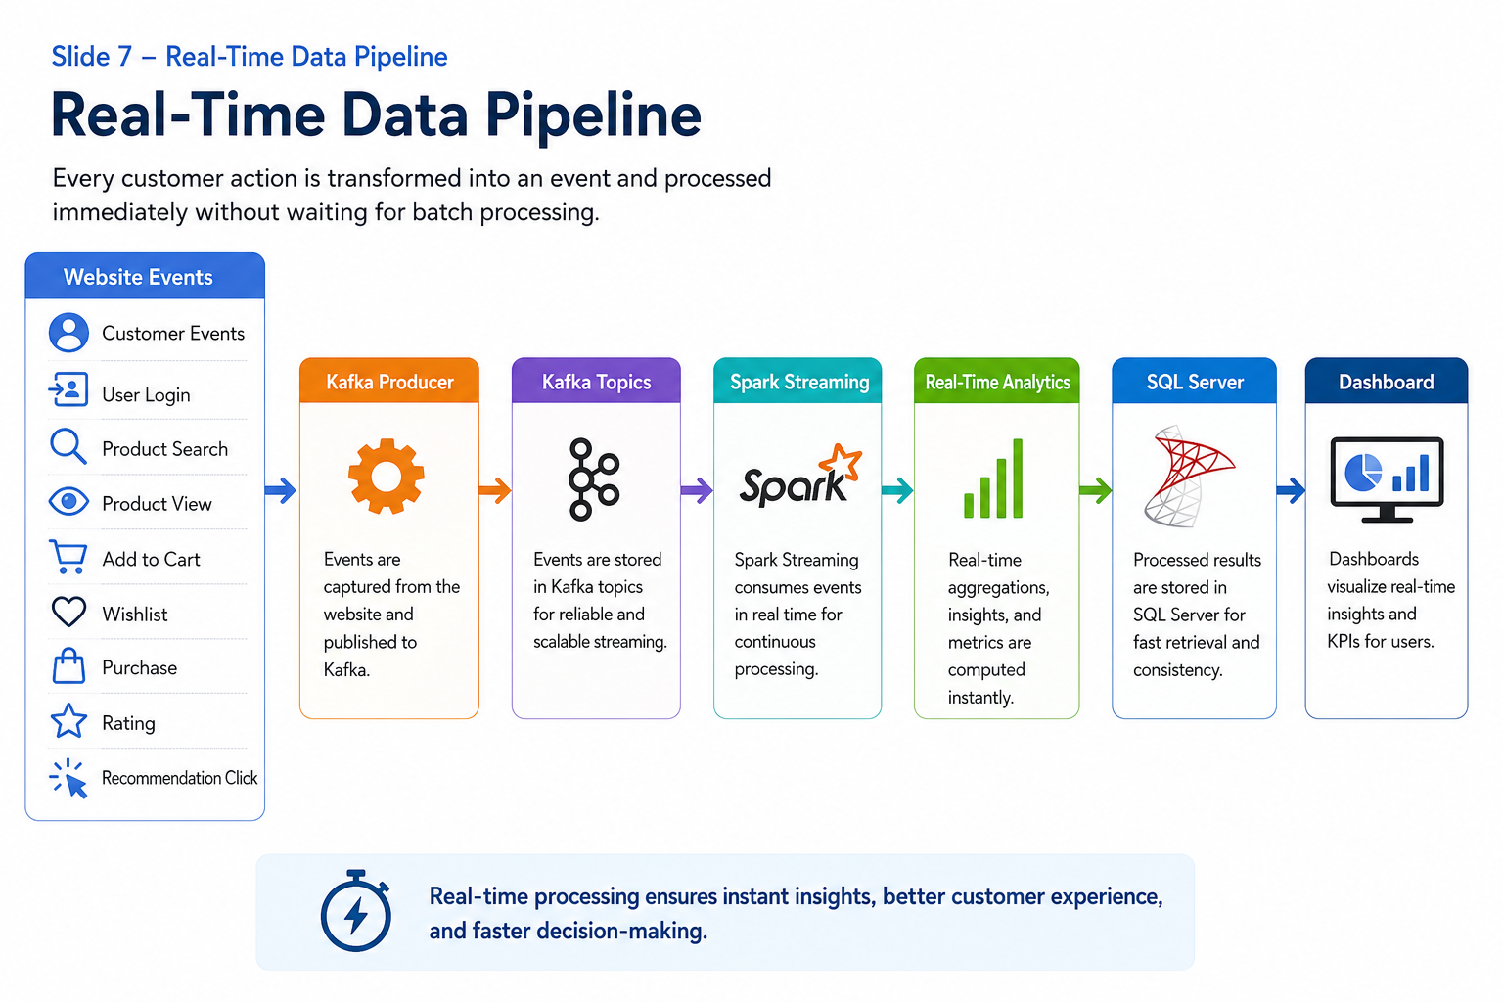
Real-Time Data Pipeline

Slide 10

Apache Kafka
Apache Kafka
Apache Kafka is a distributed event streaming platform responsible for collecting and transporting customer events reliably between the website and the analytics engine.
Why Kafka?
High Throughput
Fault Tolerance
Scalability
Low Latency
Distributed Architecture
Reliable Message Delivery
Kafka Responsibilities
Receive customer events
Store event streams
Publish events
Support multiple consumers
Ensure reliable processing

Slide 11

Apache Spark Streaming
Apache Spark Streaming
Spark Streaming continuously consumes events from Kafka and transforms raw customer interactions into meaningful business insights.
Spark Performs
Event aggregation
Filtering
Session analytics
Customer behavior analysis
Sales analytics
Recommendation metrics
Conversion analysis
Trending products
Instead of waiting until the end of the day, Spark updates analytics every few seconds.

Slide 12
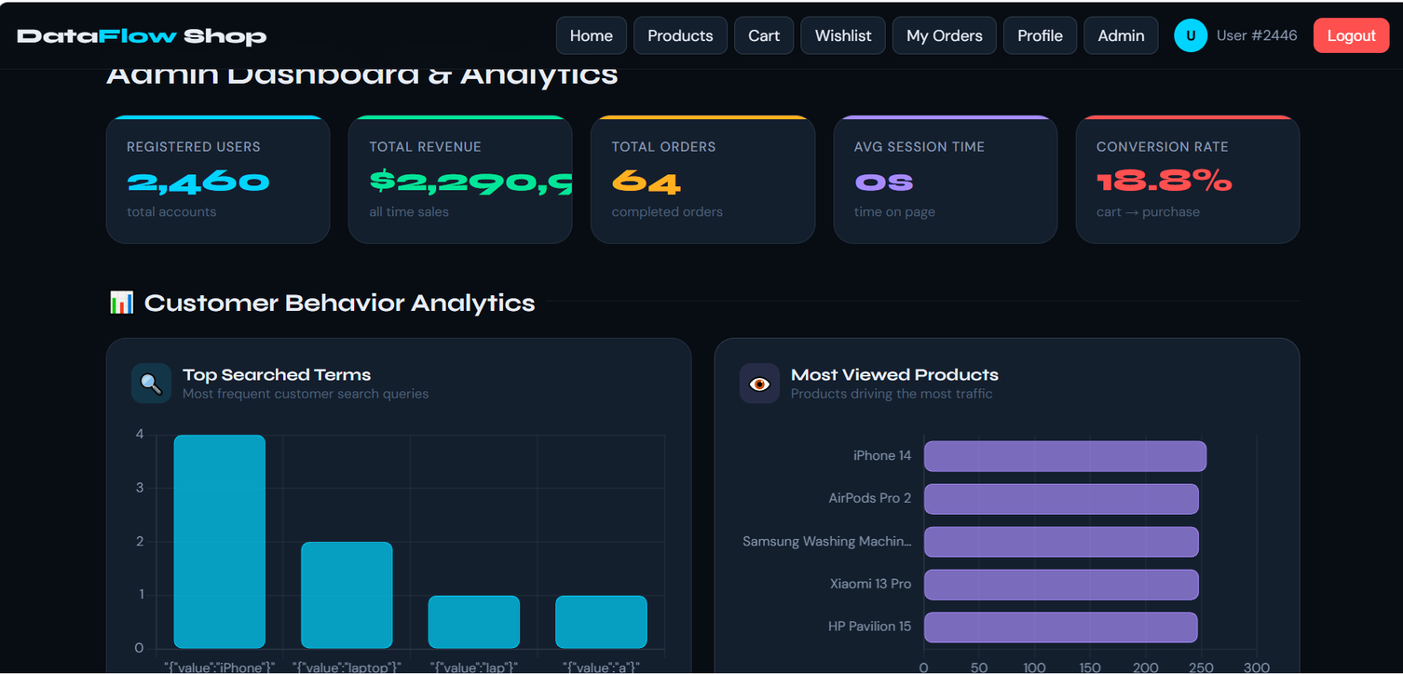
Customer Behavior Analysis
Customer Behavior Tracking
The system continuously tracks:
Product Views
Product Searches
Purchases
Wishlist
Cart Activities
Ratings
Recommendation Clicks
Session Duration

Slide 13

website Technology
Frontend Technologies
Next.js
Built the web application's user interface.
Supports server-side rendering for improved performance and SEO.
Provides fast page loading and efficient routing.
React.js
Developed reusable and interactive UI components.
Enables dynamic updates without reloading the page.
Improves user experience through a responsive interface.
TypeScript
Adds static typing to JavaScript.
Reduces development errors.
Improves code maintainability and scalability.
Tailwind CSS
Creates a modern and responsive user interface.
Simplifies styling with utility-first CSS classes.
Ensures consistent design across all pages.

Slide 14

website Technology
Backend Technologies
Node.js
Handles server-side logic and API requests.
Provides high performance using asynchronous programming.
Supports multiple concurrent client connections.
Express.js
Simplifies backend development.
Builds RESTful APIs for communication between the frontend and database.
Manages authentication, routing, and business logic.

Slide 15
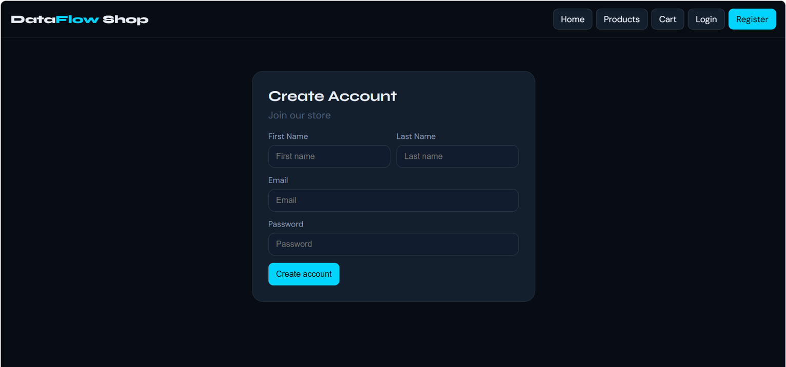
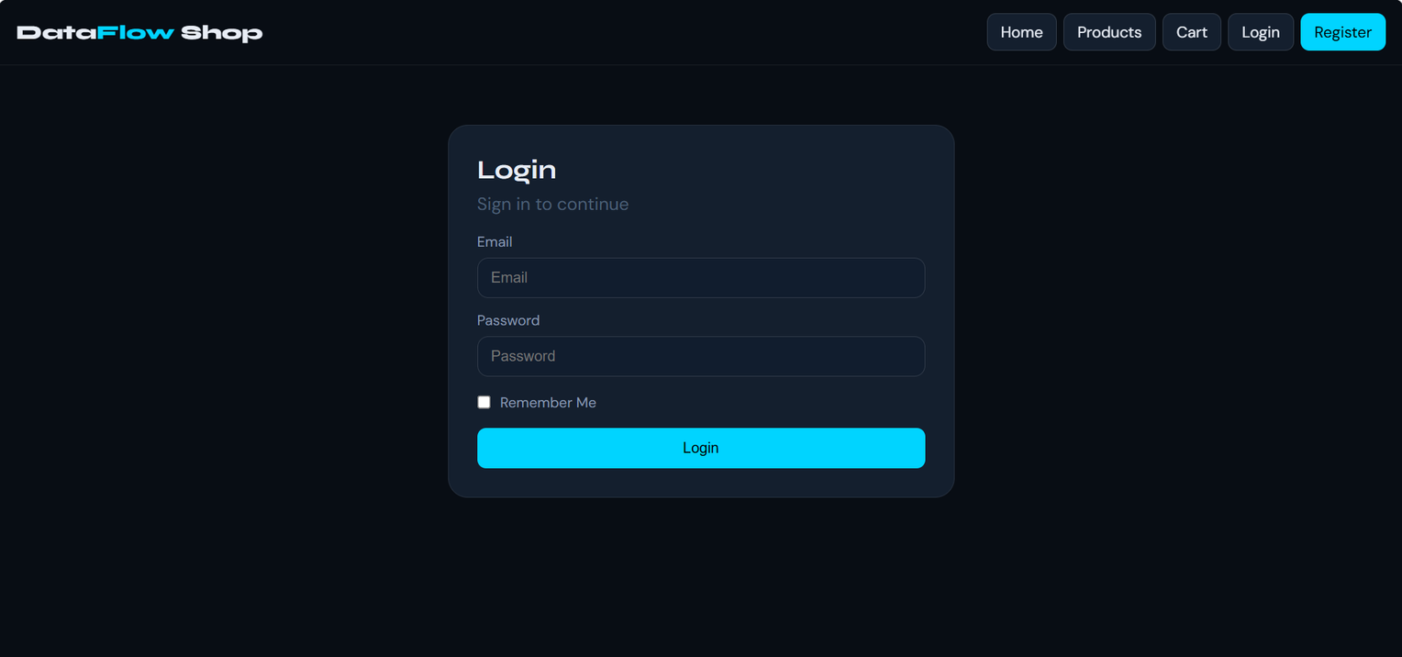
Website Features
User Features
Secure user registration and login.
Session management for personalized experiences.
AI & Automation

Slide 16
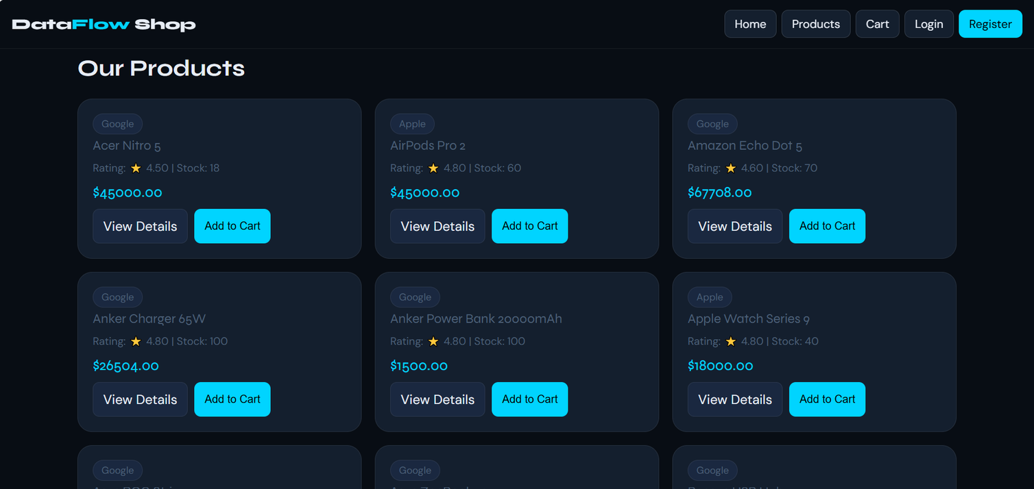
Website Features
Product Catalog
Browse products by category.
View detailed product information.
Search and filter products efficiently.
Shopping Cart
Add or remove products.
Update quantities.
Calculate total order cost automatically.
AI & Automation

Slide 17
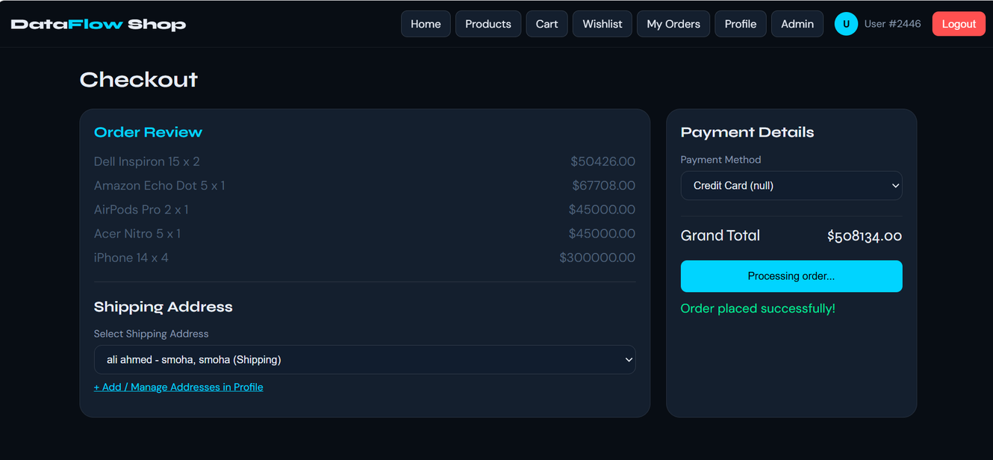
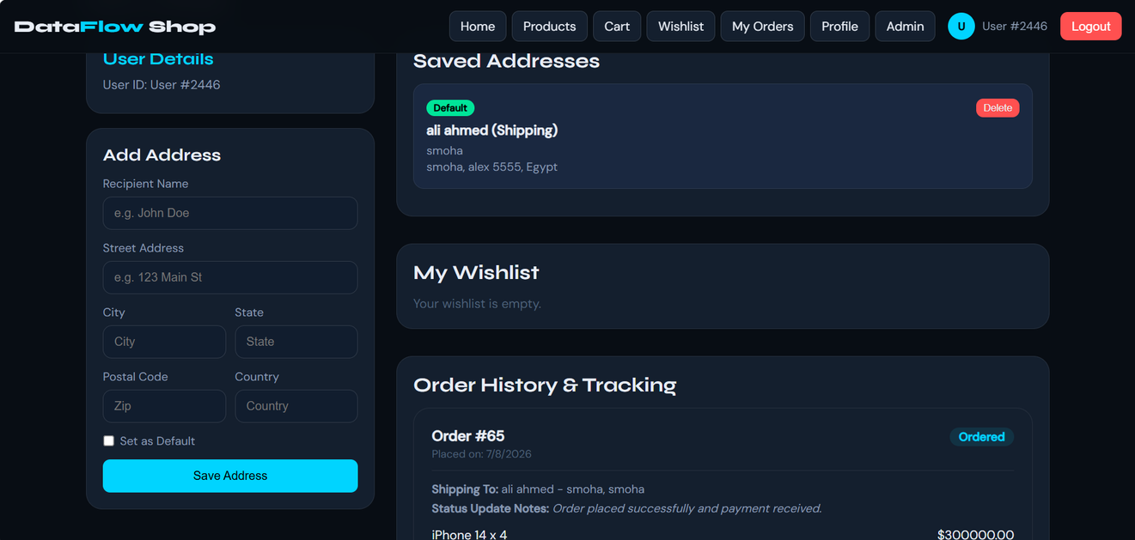
Website Features
Checkout System
Review selected products.
Select payment method.
Complete purchases securely.
Update inventory automatically.
User Profile
Manage personal information.
View order history.
Manage shipping addresses.
Track previous purchases.
AI & Automation

Slide 18
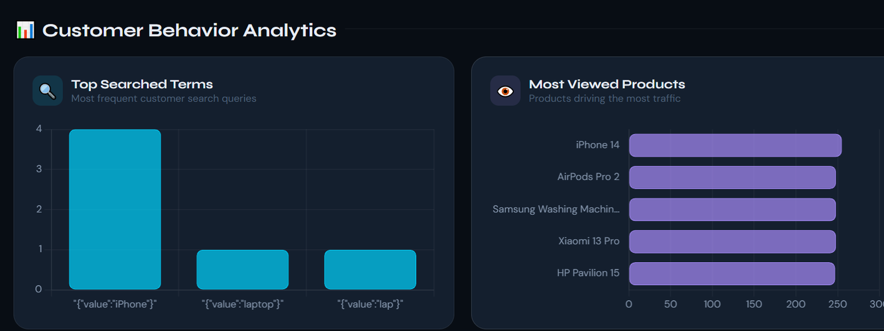
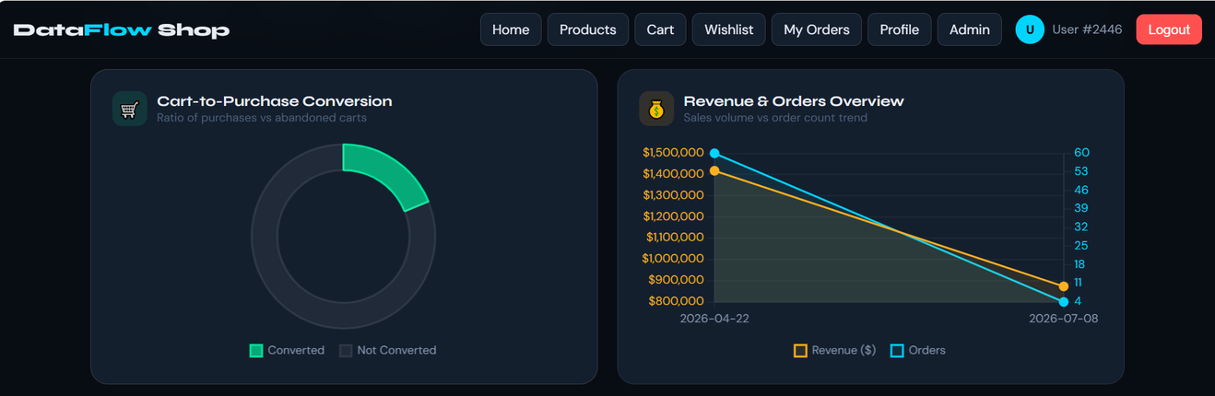
Website Features
Admin Features
Analytics Dashboard
Displays real-time business KPIs such as:
Total Users
Revenue
Orders
Active Sessions
Conversion Rate
Average Session Duration
AI & Automation

Slide 19


Future Enhancement
Admin Panel Separation
Dedicated admin portal with enhanced security and role-based access.
AI Smart Search
Natural language product search with intelligent recommendations.
AI Chatbot
24/7 virtual shopping assistant for customer support and product recommendations.
Mobile Application
Android and iOS app with synchronized user accounts.
Online Payment Integration
Support for secure payment gateways (Stripe, PayPal, Visa/Mastercard).
Advanced Analytics
AI-driven sales forecasting, customer behavior analysis, and business insights.
AI & Automation

Slide 20

Future Enhancement
Data Warehouse Integration
As the platform scales, we plan to integrate a Data Warehouse to store historical customer behavior and business data. Unlike the operational SQL Server database, the Data Warehouse will support large-scale analytical queries and long-term reporting.
Key Enhancements
Integrate a centralized Data Warehouse for historical data storage.
Implement an ETL (Extract, Transform, Load) process to transfer data from SQL Server.
Enable advanced Business Intelligence (BI) and reporting.
Support trend analysis and customer segmentation.
Improve decision-making using historical analytics.
Enable integration with visualization tools such as Power BI or Tableau.
AI & Automation

Slide 21
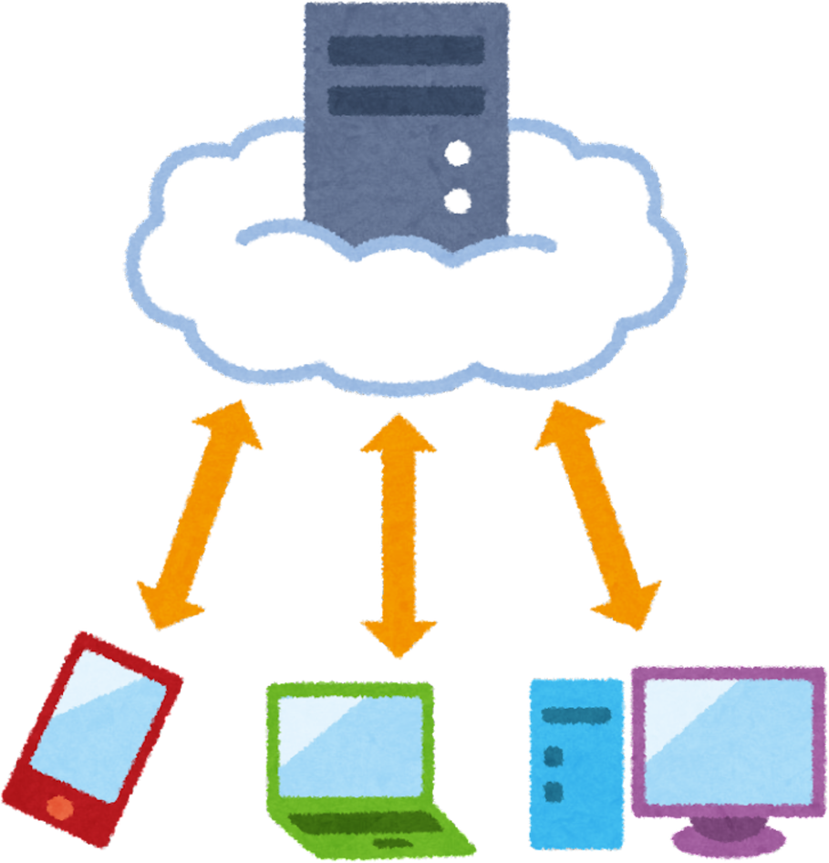
Future Enhancement
Cloud Deployment
Deploy the platform on AWS, Microsoft Azure, or Google Cloud Platform (GCP).
Improve system availability, scalability, and reliability.
Enable automatic scaling to handle increasing numbers of users and real-time events.
Provide secure, globally accessible services with managed cloud infrastructure.
Docker & Kubernetes
Containerize all application components using Docker.
Orchestrate containers with Kubernetes for simplified deployment and management.
Support automatic scaling, load balancing, and high availability.
Simplify updates and maintenance through containerized deployments.
AI & Automation

Slide 22

Future Enhancement
AI & Automation
Integrate Machine Learning models for intelligent product recommendations.
Predict customer behavior and purchasing trends using AI.
Analyze customer reviews with NLP for sentiment analysis.
Detect fraudulent or abnormal activities through AI-based anomaly detection.
Continuously retrain AI models using real-time customer behavior data.
Deliver personalized recommendations and automated business insights in real time.
AI & Automation

Slide 23


Thank You
THANK YOU FOR YOUR ATTENTION

